Slide 1
Demos
Show PWM signal changing duty cycle
Show flyback
Effect of diode
Show effect on power supply noise
Show filter on pwm line
Effect of resistor and capacitor on PWM
Show output of FET
Show affect of filter on power supply noise

Slide 2
Lab 5: The IMU, The Gimbals, and the Motor

Slide 3
The Inputs and Outputs
Gimbals – How they work and how to read them.
Brushed Motors – How they work and how to drive them.
The IMU – microcontroller and IMU communicate.
The serial display, LEDs, etc. – Communicating with the pilot.

Slide 4
Gimbals

Slide 5
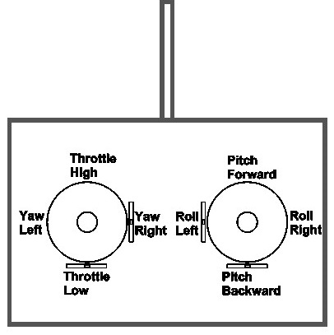
Controlling the Quadcopter
Standard RC “transmitters” have two sticks
Left: throttle and yaw
Right: pitch and roll
This is called “mode 2” It’s different in Europe where they use “mode 1”
Yaw, pitch, and roll are spring-loaded to return to neutral
Throttle stays where you put it.

Slide 6
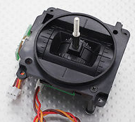
The Gimbals
Each stick is a “gimbal”
a mechanism, typically consisting of rings pivoted at right angles– The dictionary on my Mac

Slide 7
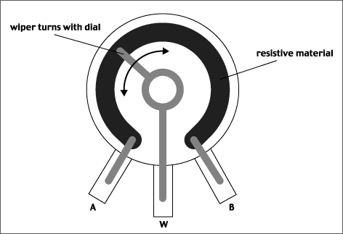
Anatomy of a Gimbal
Two potentiometers measure X and Y movement of the stick.
Potentiometer – A variable voltage divider
As the slider’s movement changes the resistance from A and W and W and B.
The voltage at W is proportional to the position of the gimbal.
In reality, the resistances are always > 0, so W never reaches VCC or GND.
Our gimbal
Frsky PR10
Total resistance: 2.4KOhms
Rated voltage: 5V

Slide 8
Reading the Gimbals
The red board board has several analog input pins
analogRead(int pin)
Takes a voltage between GND and Vcc and maps it to 0—1024
Check the schematic for the remote to see which pins are attached to which gimbals
https://github.com/NVSL/Quadcopter-Remote

Slide 9
Brushed DC Motors

Slide 10
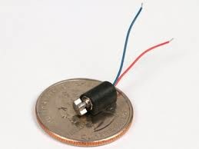
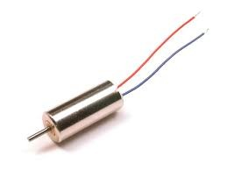
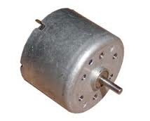
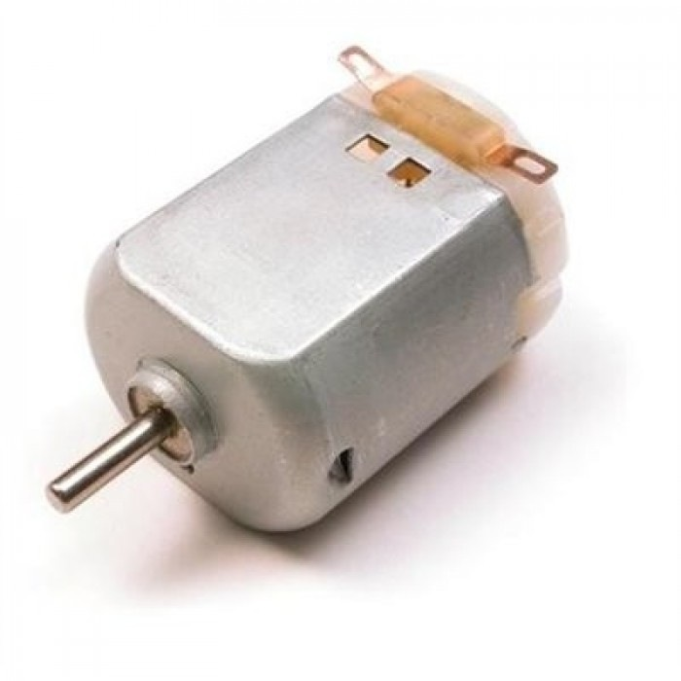
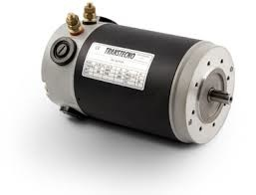
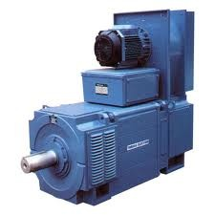
Brushed Motors

Slide 11
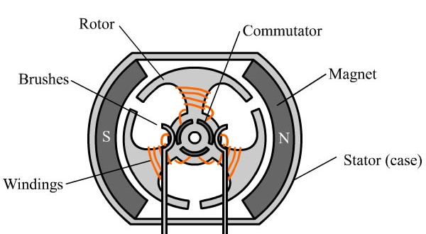
Construction

Slide 12
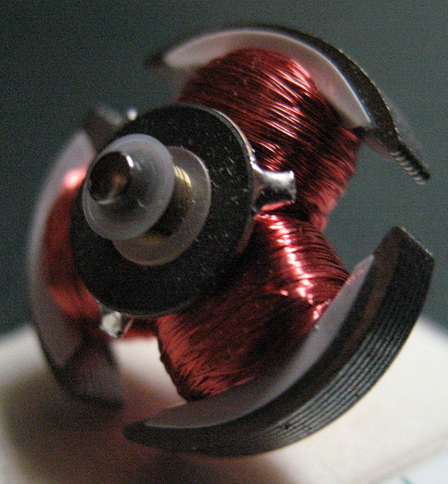
Construction (Rotor)

Slide 13
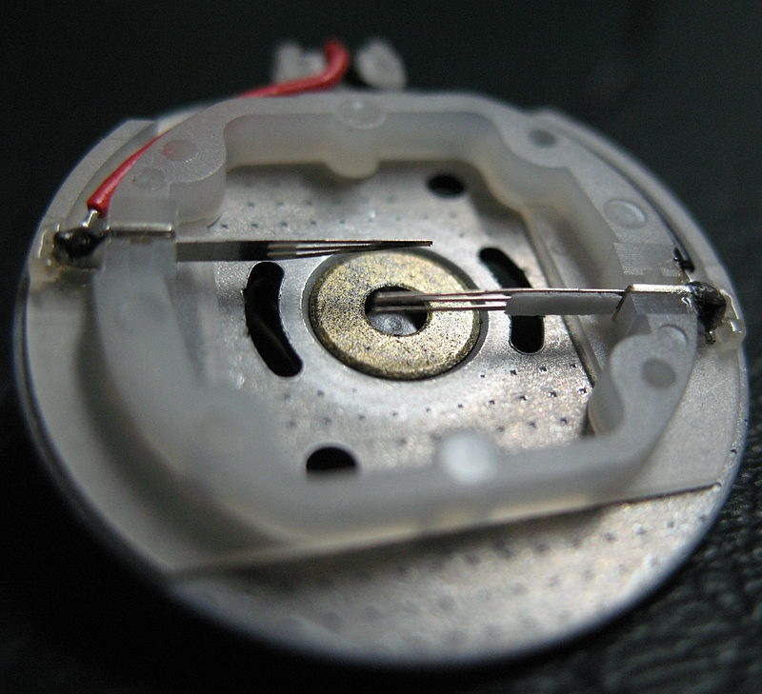
Construction (Stator)

Slide 14
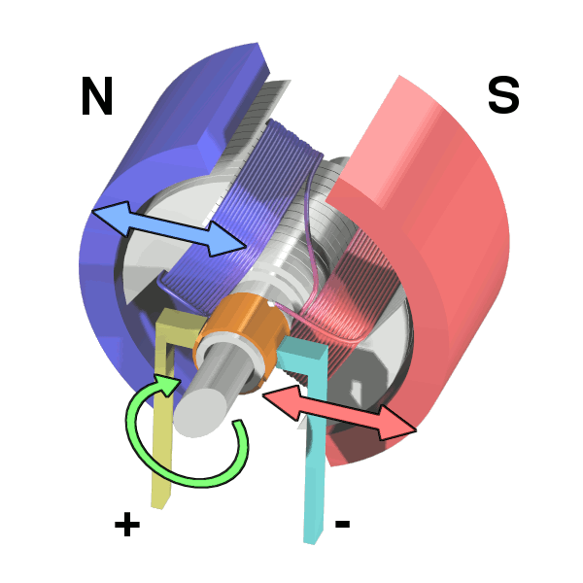
Operation

Slide 15
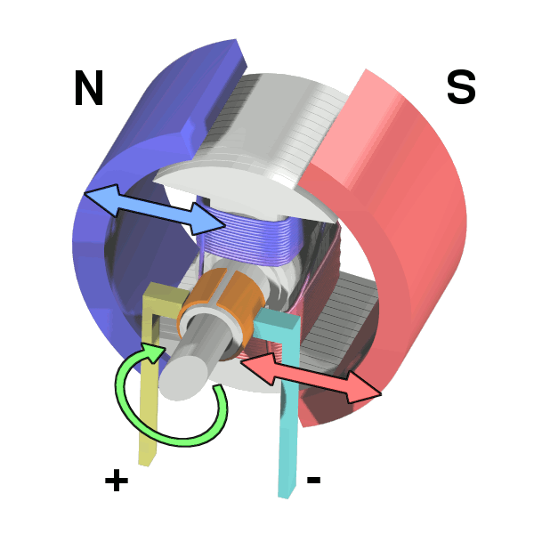
Operation

Slide 16
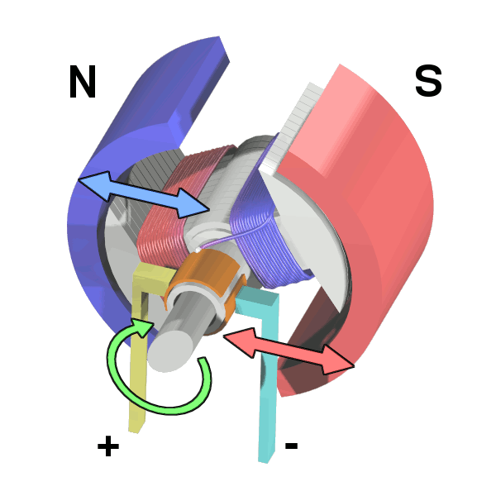
Operation

Slide 17
Operation

Slide 18
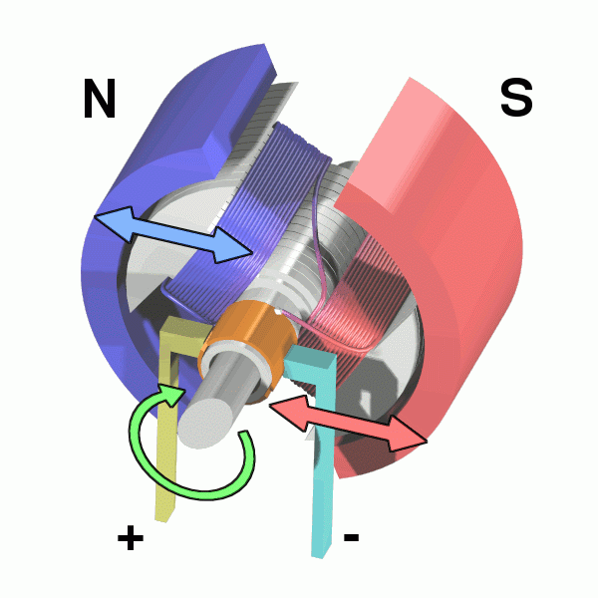
Operation

Slide 19
Flyback
Opening S1 makes M1 an inductor
Drives up voltage M1-
Can destroy the switch
Can cause current to back to power supply.
Causes noise on power supply.
This is called “fly back”
Adding a diode relieves the problem.

Slide 20
Control
How would you control your motor’s speed?
Speed ∝Voltage ∝Current
So, vary the input voltage
Generating varying voltages is non-trivial
You need an digital-to-analog converter
Really, we just need the average voltage to vary

Slide 21
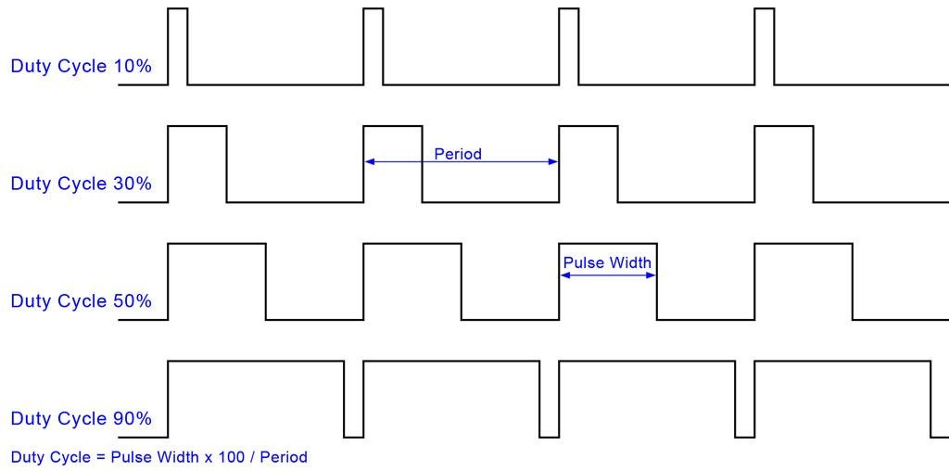
Pulse-width Modulation (PWM)

Slide 22
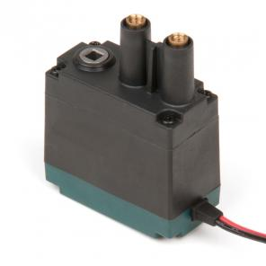
Selection
Free Speed:100 rpm
Stall Torque:8.6 in-lbs
Stall Current:2.6A
Free Current:0.18A
Specifications at 7.2V

Slide 23
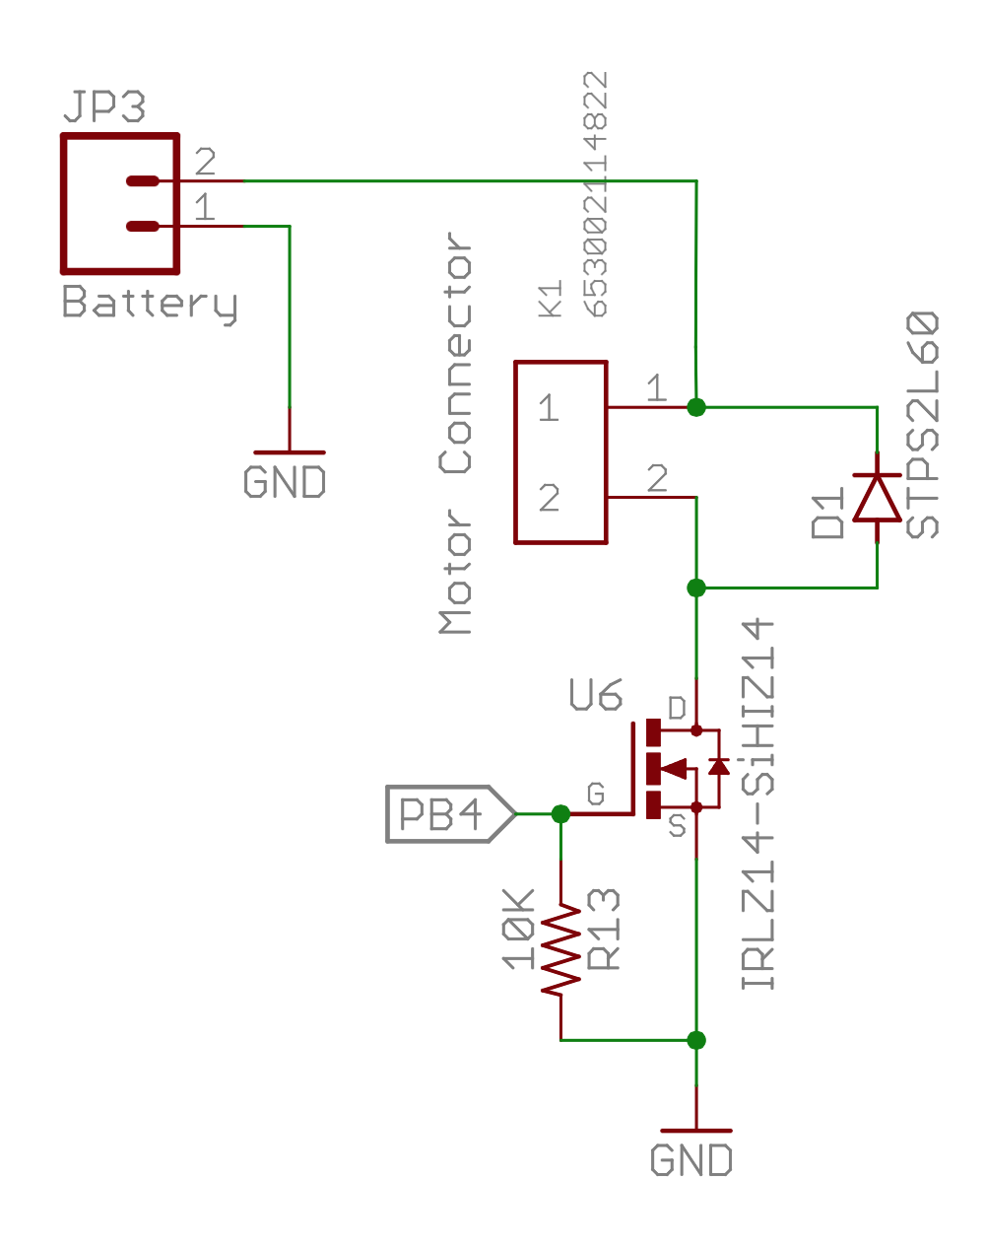
Our Motor Circuits

Slide 24
PWM in Arduino
The red board board has several analog output (PWM) pins
analogWrite (int pin)
Takes a value, x, between 0 (off) and 255 (on) and sets the duty cycle to x/255.

Slide 25
I2C

Slide 26
Inter-Integrated Circuit (I²C) Bus Interface AKA: Two Wire Interface (TWI)

Slide 27
Brief History
Designed in 1982 by Philips Semiconductor (now NXP)
1992 - First public Spec released
Since 2006 no licensing fees are required
Widely adopted technology

Slide 28
Why I²C?
Pins are precious!
They take up space
More pins → More expensive microcontrollers
Adding pins is hard
Might need a new microcontroller (if a larger, compatible one is available)
Significant board changes
Performance is often not that important
So
Use the minimum number of pins
Run them at relatively low bit rates.

Slide 29
Applications
Connecting to all kinds of small, slow peripherals
Reading Configuration data from various devices (Memory, PCI cards)
Accessing ADCs and DACs
Reading from Real-time clocks
Reading hardware monitoring devices (Fan speed, CPU Temperature, Accelerometers)
Controlling power supplies for various system components
GPIO expanders
Many, many others

Slide 30
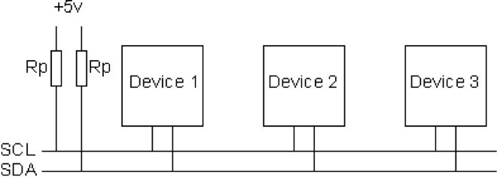
I²C Bus Architecture
Two signals
SCL – Serial Clock (used for coordination and timing)
SDA – Serial Data (used for data and control signaling)
Up to 1008 peripherals
1 or more “masters” that initiate communication on the bus
Up to 127 “slaves” that masters communicate
Bit rates
100 KHz (Standard mode)
400 KHz (Fast Mode)
3.4 MHz (High speed mode)
1 MHz (Fast Mode Plus)
5 MHz (Ultra fast mode)

Slide 31
I²C Addressing
Each slave on an I²C bus has a unique address.
Most use 7 bit addresses (we discuss this here)
An extended 10-bit version also exists
The addresses usually fixed or only partially configurable
E.g. Only the least-significant bit of the address for the IMU is settable. So you can only have two of these IMUs on one bus.
Different devices will have different numbers of settable and fixed bits.
You can’t mix components arbitrarily on the bus

Slide 32
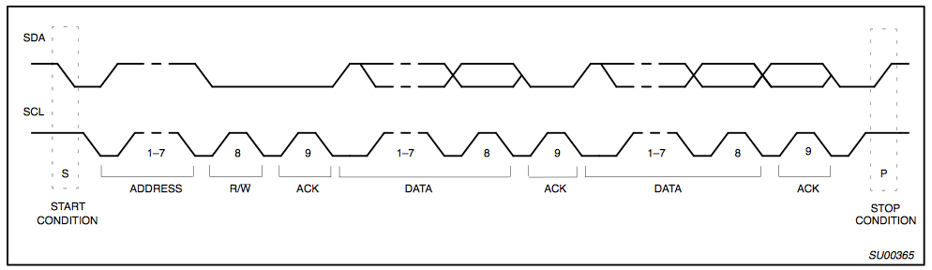
I2C Protocol - Full Xfer
Start
Philips I2C Bus Specification

Slide 33
I2C Protocol - Full Xfer
Address
R/W
Philips I2C Bus Specification

Slide 34
I2C Protocol - Full Xfer
Data
Philips I2C Bus Specification

Slide 35
I2C Protocol - Full Xfer
Stop
Philips I2C Bus Specification

Slide 36
The Serial LCD Display

Slide 37
Display Text on the Remote
The LCD display on the remote is connected to the second serial port on the redboard
The LCD_library provides a nice interface for writing to it
Docs here: http://playground.arduino.cc/Code/SerLCD

Slide 38
Other Components

Slide 39
Status LEDs
The remote has 3 status LEDs (D3, D4, D5) in the upper left of the control board.
They are useful for letting you know when the quad is armed, etc.
Use digital_write() to control them.

Slide 40
Buttons
The remote has 2 buttons (B1, B2) for your use.
Use digital_read() to see if they are pressed.

Slide 41
Pots
The remote has 2 potentiometers (TM1, TM2)
Use analog_read() to get their value.

Slide 42
Lab Tasks
Use everything
Install IMU library. Read values from IMU.
Read the values from the gimbals.
Display things on the serial display.
Drive a motor.
Turn the indicators on and off.
Read values from the pots.
Use the buttons to do something
Build a remote-controlled motor
Stand alone red board drives motor.
Remote control reads gimbals and transmits value to run motor at.
This is the basic frame work for your quadcopter and remote firmware.

